Slide 1
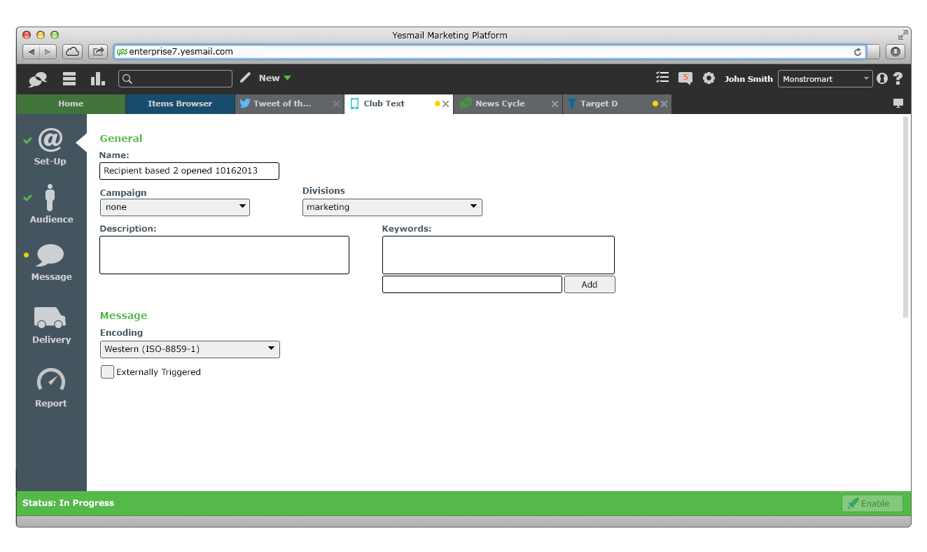
SMS Set-Up – E9
E9 with colours, fonts and layout improvements.
General elements should be indentical to their Email counterparts, in terms of layout, size.

